Slide 1
Fourier & Wavelet Transforms
BEP2021

Slide 2
General Scheme using Transforms
Problem
Equation
of the problem
Solution
of the equation
Result
Transformation
Inverse
transformation
= EASY
Transformed
equation
Solution of the
transformed equation
= HARD

Slide 3


Fourier Transforms
The Fourier Transform (FT)
decomposes a signal into the frequencies that make it up.
The Discrete Fourier Transform (DFT)
a Fourier transform on a discrete signal.

Slide 4
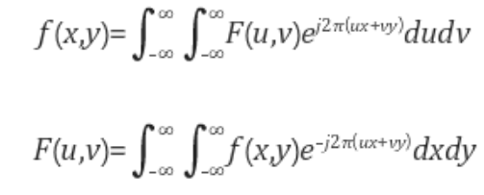
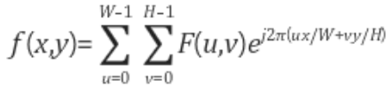

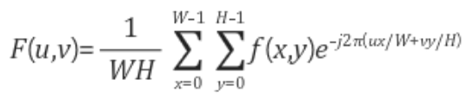

2D Fourier Transform
Continuous
Discrete
spectrum
phase

Slide 5
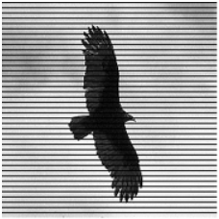
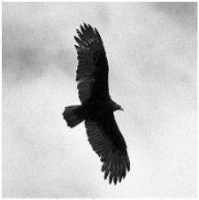
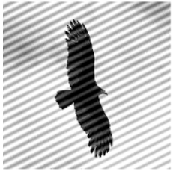
Fourier Transform & Image Processing
?

Slide 6
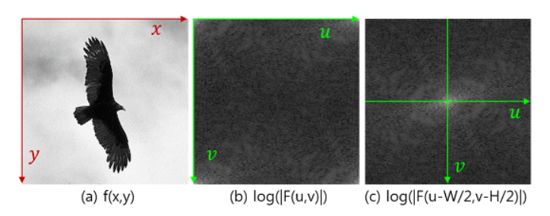
Fourier Transform & Image Processing
Low frequencies are at corners
But we can shift the spectrum because of the periodicity

Slide 7
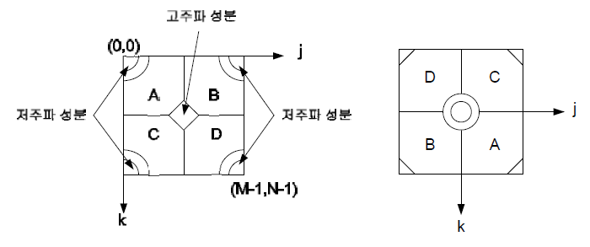


Fourier Transform & Image Processing
Shuffling quadrants
High frequencies
low frequencies
low frequencies

Slide 8
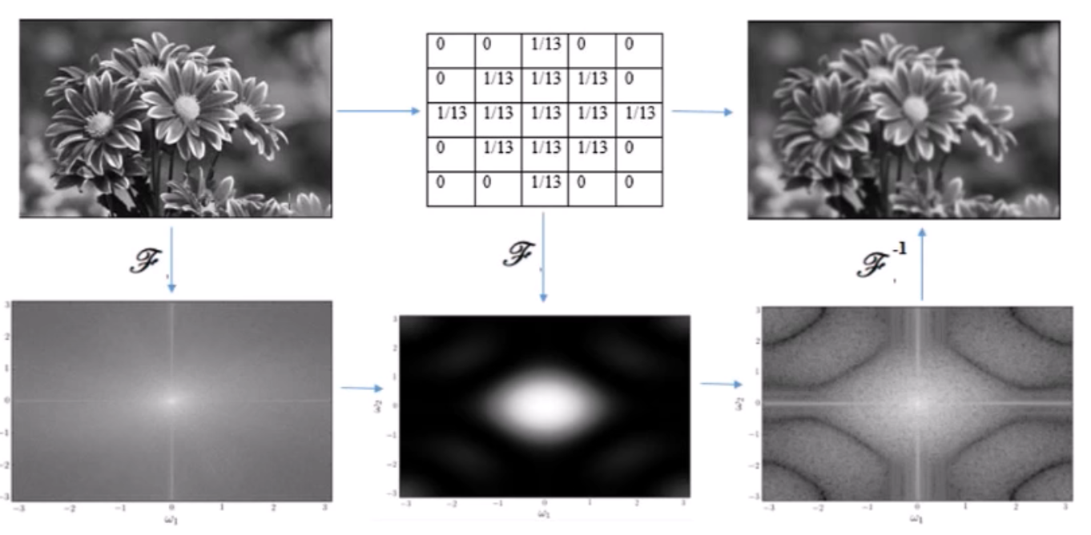
Fourier Transform & Image Processing
image source: https://www.youtube.com/watch?v=oACegp4iGi0

Slide 9
Fourier Transform & Image Processing
The Fast Fourier Transform (FFT)
a faster way to compute the DFT.
Complexity of Fast Fourier Transform (FFT) vs convolution
FFT - N * log(N)
Convolution - N * N
N | FFT | Direct Convolution
4 | 176 | 16
32 | 2560 | 1024
64 | 5888 | 4096
128 | 13,312 | 16,384
256 | 29,696 | 65,536
2048 | 311,296 | 4,194,304
Source: https://ccrma.stanford.edu/~jos/ReviewFourier/FFT_Convolution_vs_Direct.html

Slide 10
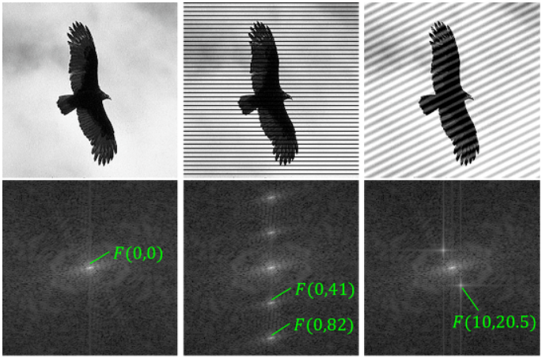
Fourier Transform & Image Processing

Slide 11
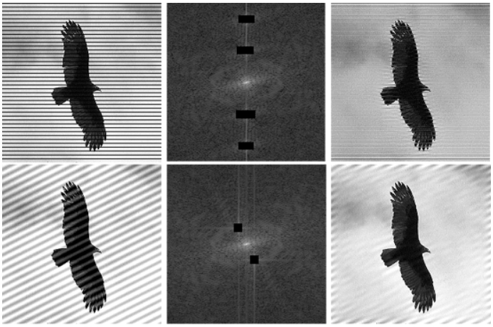
Fourier Transform & Image Processing

Slide 12
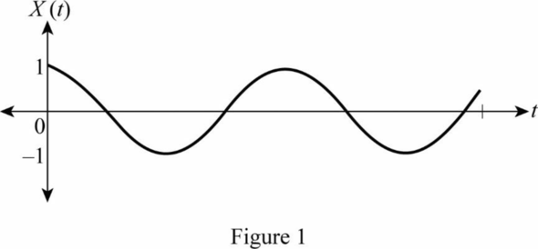
STFT
Fourier transform assumes stationary signals
No location information in time
Short-Time Fourier transform (STFT)
Analyses only a fixed length section of the signal at a time by windowing
Resolution dilemma
Resolution in time comes with the cost of resolution in frequency
Window

Slide 13
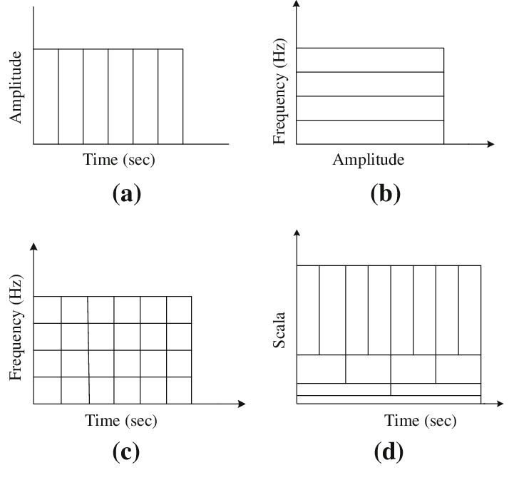
Wavelets
Overcome the resolution issue with multi- resolution analysis
Time signal
Fourier transform
STFT
wavelet transform

Slide 14

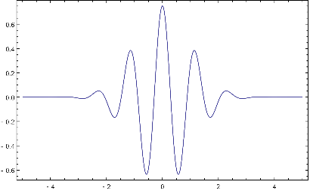
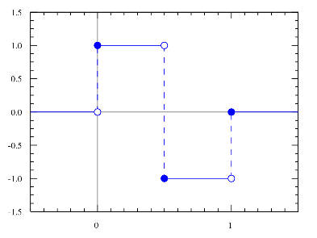
Wavelets
Wavelet
A short wavelike oscillation
The Continous Wavelet Transform (CWT)
decomposes a signal into a scaled and shifted versions of a wavelet
The Discrete Wavelet Transform (DWT)
Parameters a and b are discrete
Morlet wavelet
Haar wavelet

Slide 15
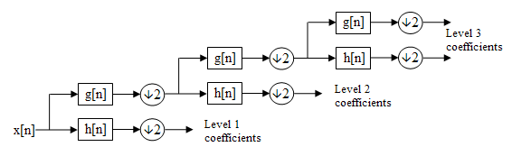
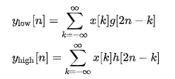
Wavelets
DWT can be easily computed with filter banks
Successively apply DWT to the approximation coefficients to obtain multi level detail coefficients.

Slide 16
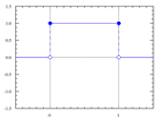
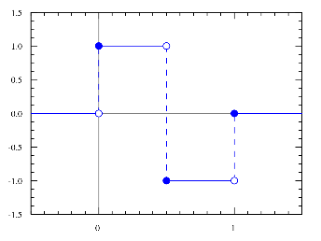
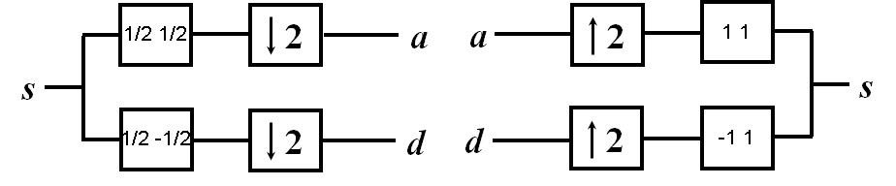
Wavelets
The simplest case is with Haar wavelet
Approximation coefficients
Analysis (deconstruction) filter g[n]
Synthesis (reconstruction) filter g’[n]
Detailed coefficients
Analysis (deconstruction) filter h[n]
Synthesis (reconstruction) filter h’[n]
The synthesis filters are same as analysis but mirrored with respect to time and scaled
You can use [½, ½] and [1,1] for approximation and [½, -½] and [-1,1] for detailed.

Slide 17
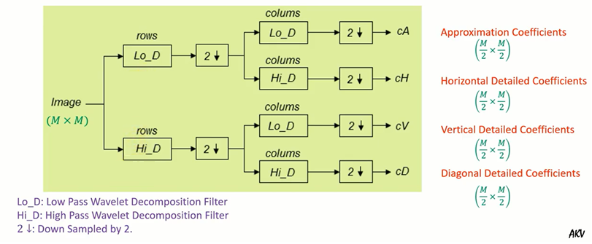
Wavelets & Image Processing
Deconstruction for 2D data
image source: https://www.youtube.com/watch?v=ExU0izGXgSI

Slide 18
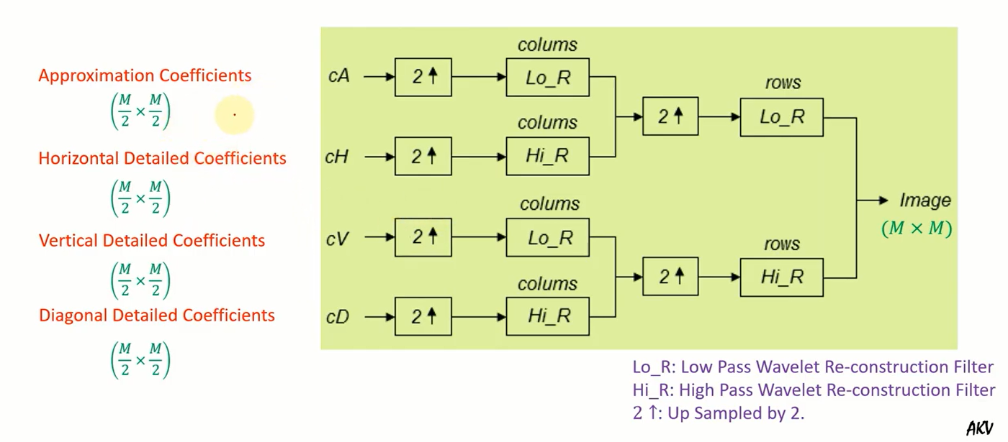
Wavelets & Image Processing
Reconstruction for 2D data
image source: https://www.youtube.com/watch?v=ExU0izGXgSI

Slide 19
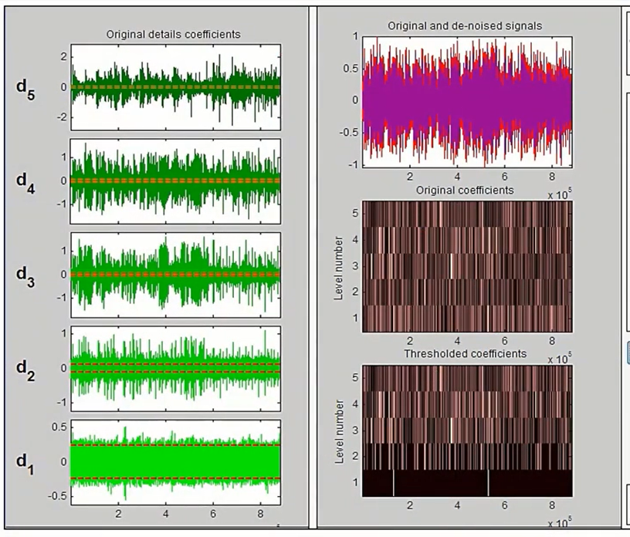
Wavelets & Image Processing
Denoising
Deconstruct by DWT until certain level
Threshold detailed coefficients at each level
Reconstruct with IDWT
image source: https://www.youtube.com/watch?v=ExU0izGXgSI

Slide 20
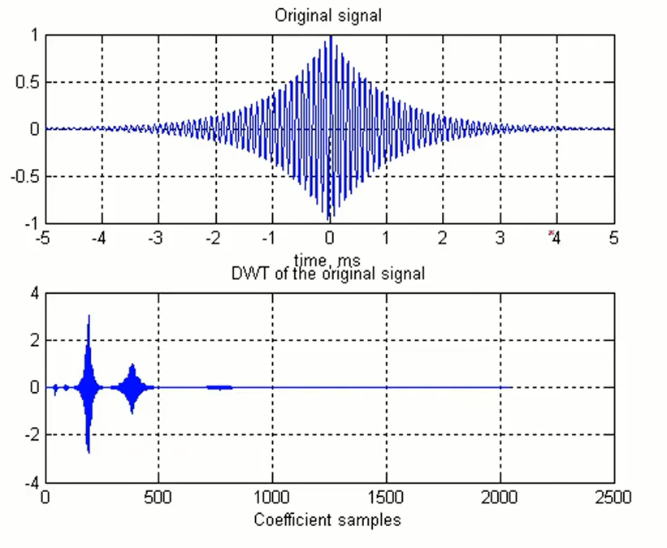
Wavelets & Image Processing
Compression
Most coefficients are small and can be zeroed with minimal degradation
We can discard the coefficients with low information content
image source: https://www.youtube.com/watch?v=ExU0izGXgSI

Slide 21
HW
Implement 2D-version of DFT and IDFT with NumPy
Take DFT of one of the noisy images.
Remove the noise on the frequency domain.
Take IDFT and show the denoised image.

